Slide 1
The enneagram
Bringing Life and Practice Into
Balance
Dr. Dave Janzen, D.Min., CIP, CAI, CISM

Slide 2
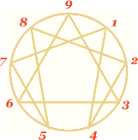

Slide 3
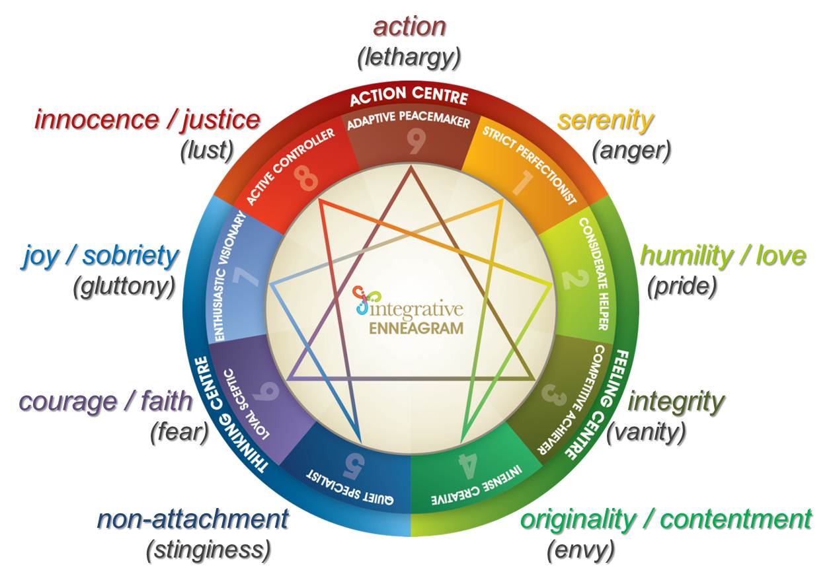

Slide 4
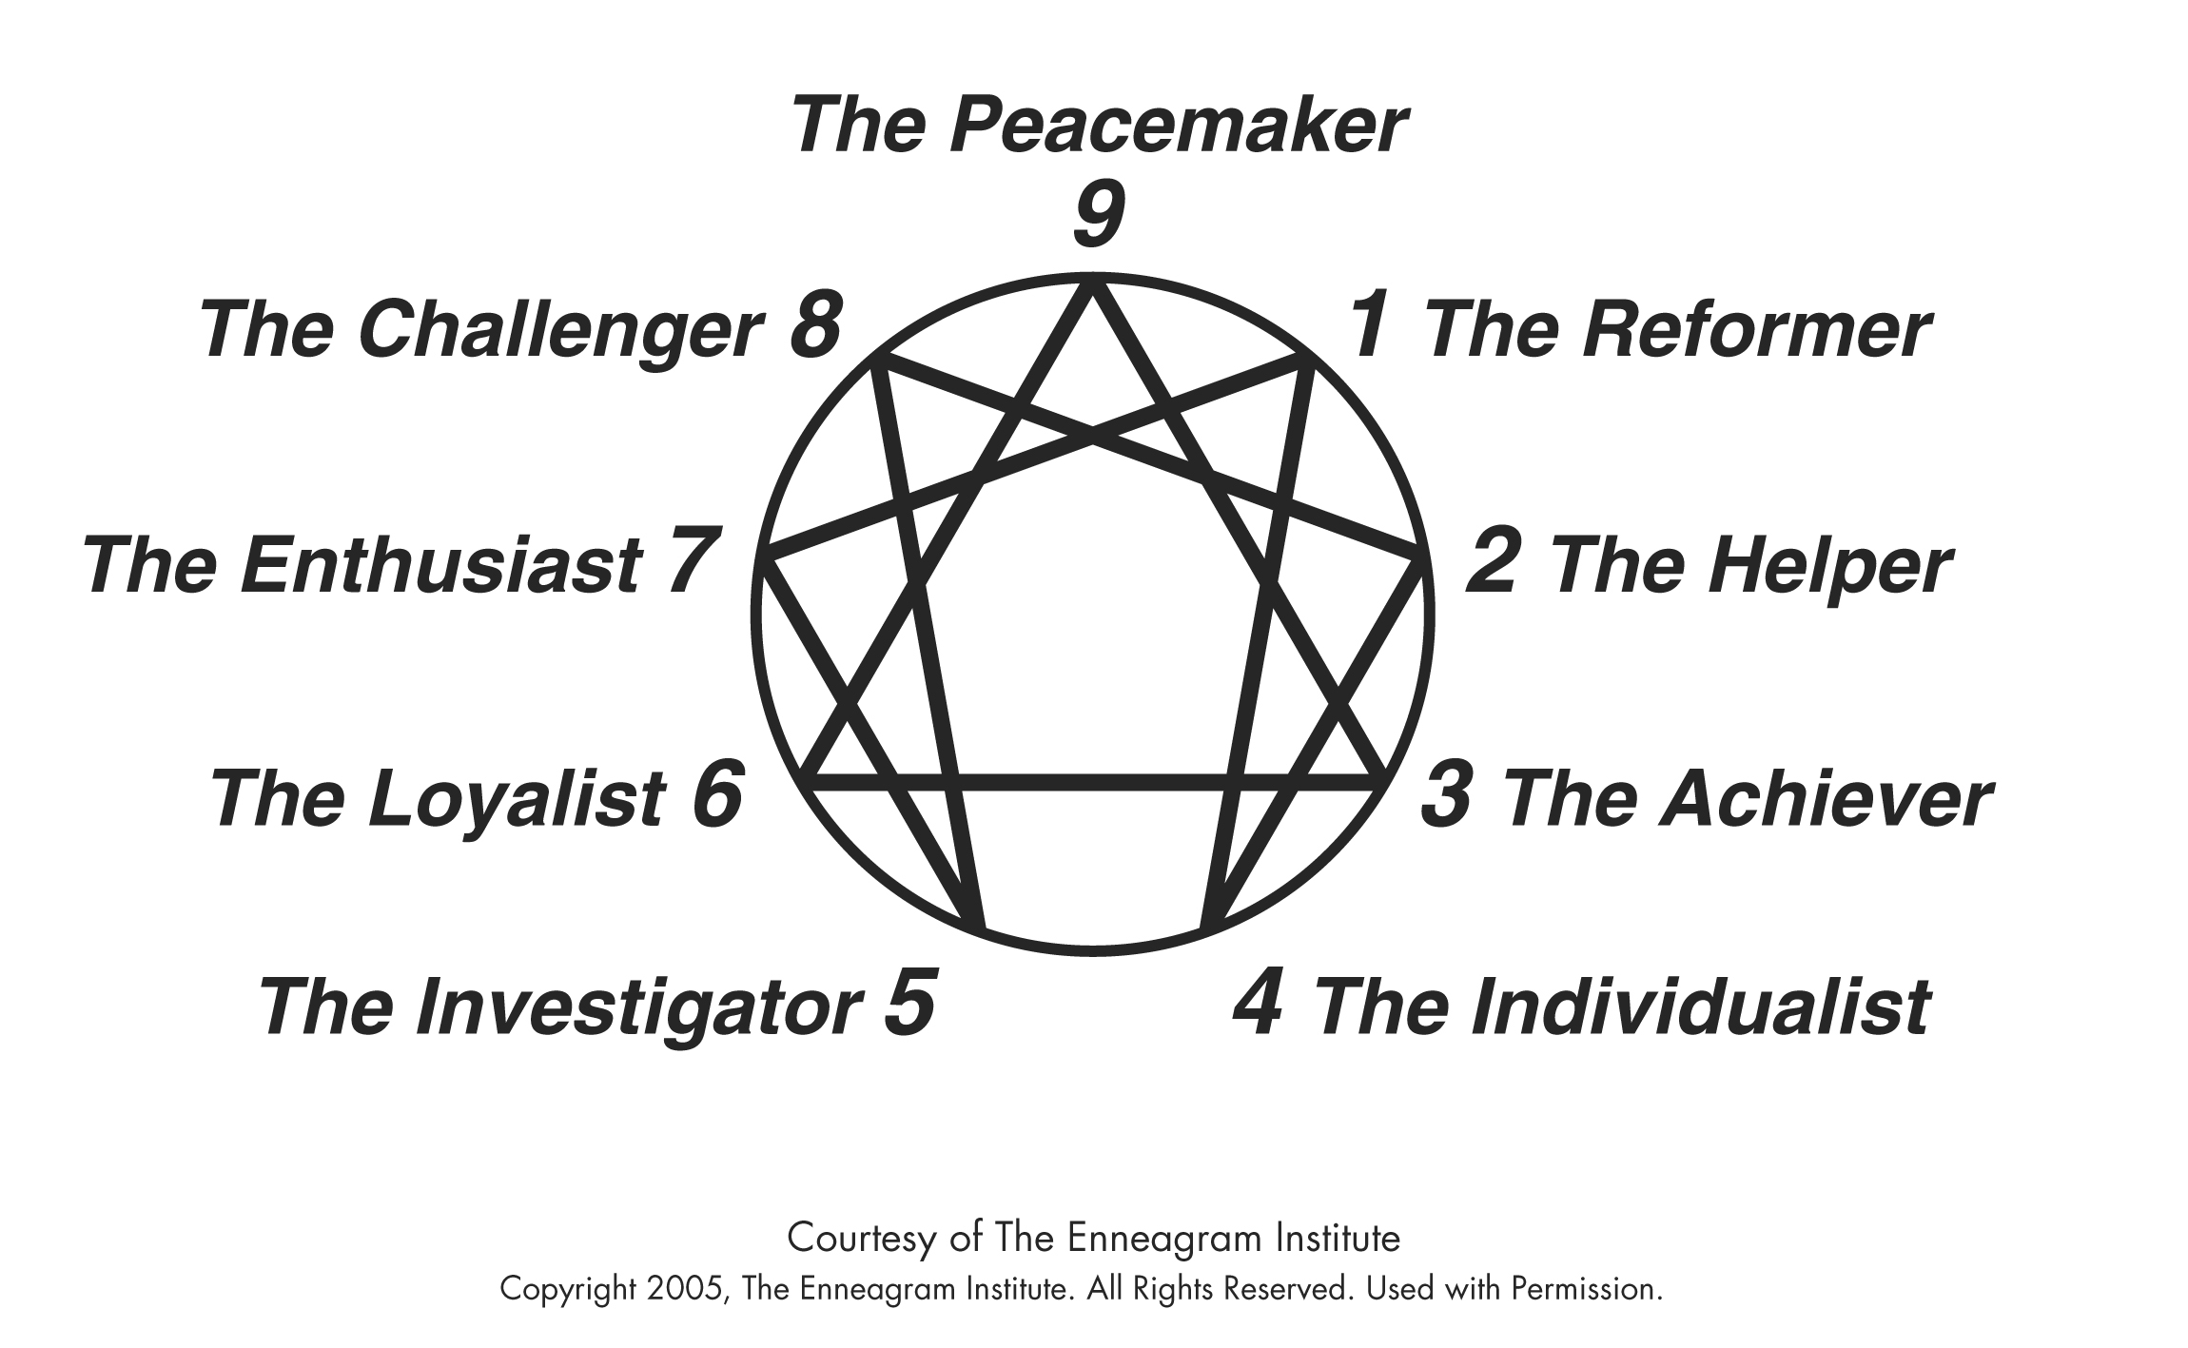

Slide 5
How I got here

Slide 6
Workshop objectives
Understand the origins and historical uses of the Enneagram
Understand the Three Centers
Understand Paths of Integration and Disintegration
Understand Levels of Health
Understand examples of application

Slide 7
Personality!
What you better have
If you're not real attractive
Fashion for the psyche:
'Cause it ain't safe to walk around naked!
A way to present ourselves to the world that feels safe enough
Personality is "The tip of the iceberg“
Personal growth is reintegration of the rest of the iceberg

Slide 8
Enneagram origins
Ancient, 3-4k y/o
Hunch: More fully developed in ancient Babylon
By the Jews in Exile
A way to better keep the Great Commandment
Origins similar to/contemporary with Kabbalah
“Love the LORD your GOD…Heart,…Mind,…Strength.”

Slide 9
3 Centers
Heart
Feeling
Head
Thinking
Gut
Instinctive

Slide 10
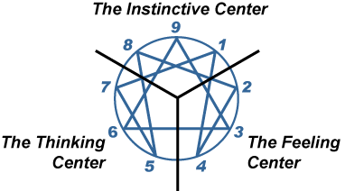

Slide 11
3 Dynamic Energies (Horneyvian Groups)
Assertive (Extrovert)
Withdrawn (Introvert)
Compliant (Dutiful, Anxious)

Slide 12
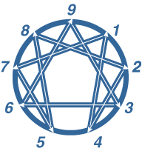
Paths
Of
Inte-
gration

Slide 13
Integration
Behaviors of other types manifest, rather than a change in type per se
Happens naturally when healthy development and intentional personal growth proceeds unimpeded
Behavioral goals can be pursued in order to facilitate growth

Slide 14
Paths
Of
Inte-
gration

Slide 15
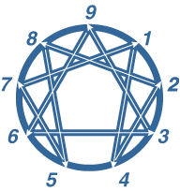
Paths
Of
Disinte-
gration

Slide 16
Disintegration
Under significant stress or illness or addiction or low levels of developmental health
Behaviors manifest rather than a change of type per se
Behaviors of disintegrative type can be part of “red flag” relapse prevention planning

Slide 17
Paths
Of
Disinte-
gration

Slide 18
Levels of development (health)
The Levels of Development are a distinct contribution to the Enneagram field by Riso & Hudson
Basic Levels are Healthy, Average, and Unhealthy
Three layers within in each Level
Very specific behavioral information is in the literature
Disaster prevention and growth can both be enriched by the info available

Slide 19
Healthy
Level 1: The Level of Liberation
Level 2: The Level of Psychological Capacity
Level 3: The Level of Social Value

Slide 20
Average
Level 4: The Level of Imbalance/ Social Role
Level 5: The Level of Interpersonal Control
Level 6: The Level of Overcompensation

Slide 21
Unhealthy
Level 7: The Level of Violation
Level 8: The Level of Obsession and Compulsion
Level 9: The Level of Pathological Destructiveness

Slide 22
Type One The Reformer
The principled, idealistic type. Ones are conscientious and ethical, with a strong sense of right and wrong. They are teachers, crusaders, and advocates for change: always striving to improve things, but afraid of making a mistake. Well-organized, orderly, and fastidious, they try to maintain high standards, but can slip into being critical and perfectionistic. They typically have problems with resentment and impatience. At their Best: wise, discerning, realistic, and noble. Can be morally heroic.

Slide 23
Type Two The Helper
The caring, interpersonal type. Twos are empathetic, sincere, and warm-hearted. They are friendly, generous, and self-sacrificing, but can also be sentimental, flattering, and people-pleasing. They are well-meaning and driven to be close to others, but can slip into doing things for others in order to be needed. They typically have problems with possessiveness and with acknowledging their own needs. At their Best: unselfish and altruistic, they have unconditional love for others.

Slide 24
Type Three The Achiever
The adaptable, success-oriented type. Threes are self-assured, attractive, and charming. Ambitious, competent, and energetic, they can also be status-conscious and highly driven for advancement. They are diplomatic and poised, but can also be overly concerned with their image and what others think of them. They typically have problems with workaholism and competitiveness. At their Best: self-accepting, authentic, everything they seem to be—role models who inspire others.

Slide 25
Type Four The Individualist
The introspective, romantic type. Fours are self-aware, sensitive, and reserved. They are emotionally honest, creative, and personal, but can also be moody and self-conscious. Withholding themselves from others due to feeling vulnerable and defective, they can also feel disdainful and exempt from ordinary ways of living. They typically have problems with melancholy, self-indulgence, and self-pity. At their Best: inspired and highly creative, they are able to renew themselves and transform their experiences.

Slide 26
Type Five The Investigator
The perceptive, cerebral type. Fives are alert, insightful, and curious. They are able to concentrate and focus on developing complex ideas and skills. Independent, innovative, and inventive, they can also become preoccupied with their thoughts and imaginary constructs. They become detached, yet high-strung and intense. They typically have problems with eccentricity, nihilism, and isolation. At their Best: visionary pioneers, often ahead of their time, and able to see the world in an entirely new way.

Slide 27
Type Six The Loyalist
The committed, security-oriented type. Sixes are reliable, hard-working, responsible, and trustworthy. Excellent "troubleshooters," they foresee problems and foster cooperation, but can also become defensive, evasive, and anxious—running on stress while complaining about it. They can be cautious and indecisive, but also reactive, defiant and rebellious. They typically have problems with self-doubt and suspicion. At their Best: internally stable and self-reliant, courageously championing themselves and others.

Slide 28
Type Seven The Enthusiast
The busy, productive type. Sevens are extroverted, optimistic, versatile, and spontaneous. Playful, high-spirited, and practical, they can also misapply their many talents, becoming over-extended, scattered, and undisciplined. They constantly seek new and exciting experiences, but can become distracted and exhausted by staying on the go. They typically have problems with impatience and impulsiveness. At their Best: they focus their talents on worthwhile goals, becoming appreciative, joyous, and satisfied.

Slide 29
Type Eight The Challenger
The powerful, aggressive type. Eights are self-confident, strong, and assertive. Protective, resourceful, straight-talking, and decisive, but can also be ego-centric and domineering. Eights feel they must control their environment, especially people, sometimes becoming confrontational and intimidating. Eights typically have problems with their tempers and with allowing themselves to be vulnerable. At their Best: self-mastering, they use their strength to improve others' lives, becoming heroic, magnanimous, and inspiring.

Slide 30
Type Nine The Peacemaker
The easy-going, self-effacing type. Nines are accepting, trusting, and stable. They are usually grounded, supportive, and often creative, but can also be too willing to go along with others to keep the peace. They want everything to go smoothly and be without conflict, but they can also tend to be complacent and emotionally distant, simplifying problems and ignoring anything upsetting. They typically have problems with inertia and stubbornness. At their Best: indomitable and all-embracing, they are able to bring people together and heal conflicts.

Slide 31
Example

Slide 32
thoughts

Slide 33
Questions?

