Slide 1
The Ethics of Reactivity: Dealing with Difficult Patients and Their Families
“Dr. Dave” Janzen, D. Min., CISM, CAI
Certified Intervention Professional #I0175
“The Motiventionist”
http://www.motiventionist.com/
Rev. 9-14-2015

Slide 2
Objectives
Define Emotional Reactivity
Explore the Neurobiology of Emotional Reactivity
Adopt Strategies for Managing Emotional Reactivity

Slide 3
Disclosure
The presenter has a distinct bias against addiction and this bias may appear throughout the presentation.
The presenter has no financial interest or conflict in the presentation.

Slide 4
Why me?
Bioethics?
Expertise in Emotional Reactivity?
Congregational Life
Personal Experience
Intervention

Slide 5
Emotional Reactivity Defined
A stress-induced state of relational transaction, where agent and respondent are in heightened states of emotional arousal, with the intensity of the transaction frequently both cyclical and escalating. It can manifest as aggressive, passive, and passive-aggressive.
(This is my working definition)

Slide 6
Emotional Reactivity is Reptilian Behavior (e.g., addiction)
For families that have had to deal with the impact of addiction
Report “S/he has become a different person.”
“We want our old ______ back”
Confirmation that some of their behavior is:
Reactive
Hostile
Defensive
It’s an opportunity to ask, “Would you like to know why?”
And, “Would you like to know what to do about it?”

Slide 7
Medusa -Bernini

Slide 8
The Myth of Medusa
From Greek Mythology
A beautiful priestess of Athena
Tryst with Poseidon, cursed by Athena
Rings true through the ages because of the power of reptilian behavior
Association of reptilian with frightening, deceptive, and deadly
Including many major religions
And some ex-partners
Notes:
In Greek mythology, Medusa was originally a beautiful priestess of Athena, but a tryst with Poseidon incited Athena to curse her with the hideous appearance that could turn men to stone.
With reptilian effectiveness, addiction hijacks the human brain and sucks the vitality out of a person.
Addiction turns good, loving people into difficult, reptilian reactors.

Slide 9
It’s all about that Brain

Slide 10
It’s all about the neurons
Density
Complexity
Ratio
2-3% of body mass
Uses 15-20% of calories
Organic network of each neuron with the whole brain

Slide 11
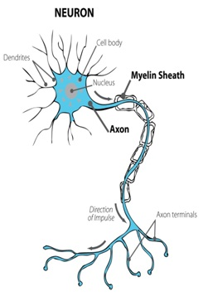

Slide 12
Two modes of communication
Along the neuron
From the nucleus down to the axon terminals
Electrical impulses signal instructions to release NT
Between neurons
Neurochemical
Neurotransmitters:
Serotonin, Norepinephrene, Dopamine, glutamate, GABA, etc.
Other neuropeptides

Slide 13
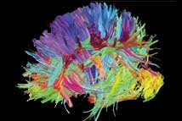
Notes:
A map of the communication pathways in the brain.

Slide 14
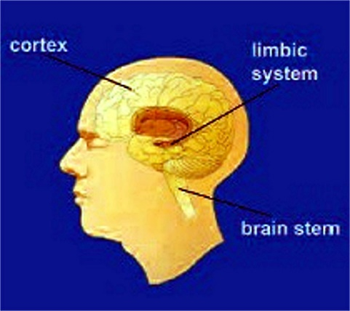
The Brain’s 3 Layers
Upper Layer: Cerebral Cortex
Mid-Brain/Limbic System:
Brainstem:
Survival
Reactive
“Reptilian”
“Snakes on a Brain”

Slide 15
Cerebral Cortex
Our most-recently-evolved region of the brain
The most significant difference compared to the brains of other species on the planet
Sperm Whale – 17 lbs. of brain, most dedicated to musculoskeletal management
Human brain – 3 lbs.
Human brain has far more neurons, highest ratio of cerebral cortex to body mass & rest of brain of any species
The Cortex is dedicated to integrating sensory & reflective information related to our Social Nature
Cortex is most like a “social computer”

Slide 16
Relationship to our development as “Human”
500,000 years ago, started using tools
50,000 years ago, started using fire to cook food
Allowed migration to colder regions
Cooking food made more calories available
More calories made larger “calorie hog” brains possible
Nevertheless, ancestors always near extinction
Exposure
Starvation
Disease
Competition

Slide 17
The Cortex as “Social Computer”
Our social nature put us at the top of the food chain
Massive processing is required for:
Language
Tone of voice and facial expression
Social group cues of:
Hierarchy, Threat, Nurture
Social interaction with the environment
Hunting/gathering
Security
Shelter
Technology – knowledge & skill accumulation/sharing

Slide 18
The Mid-Brain, Limbic System
Emotional and sensory processing and response
The primary feeling and reacting centers
Many separate structures for self and species preservation
Amygdala – Fear, Rage & reactivity with environmental cues
Hippocampus – Memory and Spatial interaction; Patterns
Hypothalamus – Endocrine, Sexual, and Autonomic control
Temperature regulation
Arousal and Craving
Hypothalamus also outputs limbic processes to the rest of the brain
Found in the earliest mammals and since

Slide 19
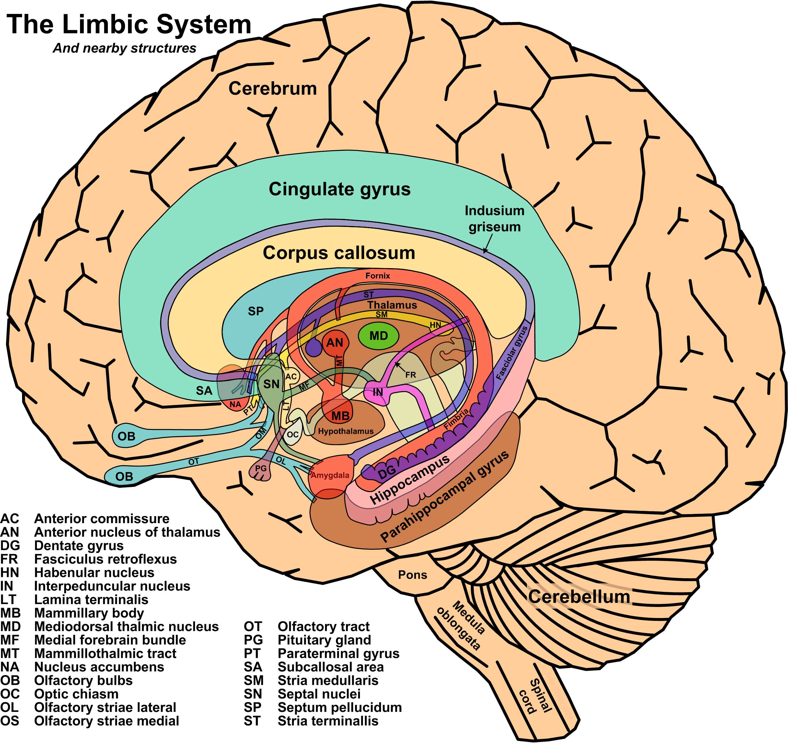

Slide 20
The Reptilian Mind
So-called because it’s as far as reptiles evolved
Reptiles don’t nurture their young
Reptiles are purely reactive creatures
Includes the Brainstem and Cerebellum (coordination)
The Locus Coeruleus, Amygdala, and HPA-axis

Slide 21
Emergence of the Reptilian Mind in Hospital Settings
Assumption: No patient enters the hospital for a good time.
If you are sick, the reptilian mind is activated.
When feeling threatened, the most reasonable person may become quite unreasonable.
“Snakes on a brain!”

Slide 22
How is this about Ethics?
Ethics, Oxford Dictionary:
1 [USUALLY TREATED AS PLURAL] Moral principles that govern a person’s or group’s behavior:
Judeo-Christian ethics
1.1The moral correctness of specified conduct:
the ethics of euthanasia

Slide 23
Principles of Biomedical Ethics
Beauchamp TL, Childress JF. Principles of biomedical ethics, 5th ed. New York City, NY: Oxford University Press; 2001.
Autonomy
Beneficence
Nonmaleficence
Justice

Slide 24
What about the relationship?
In the middle of conflict, are we going through a mental checklist of the principles?
Shorthand: Ethics is about the relationship, specifically:
When one party needs something that the other party has, an imbalance is created which distresses the relationship
Ethics is about re-balancing the relationship
Until it’s re-balanced, reactivity is likely

Slide 25
In Conflict, Job #1: Managing Reactivity
Because illness activates the “reptilian mind”
“Snakes on a Brain”
Reactivity is a defense mechanism
Reactivity is contagious!
Cats metaphor
Expect reactivity to emerge
Prepare to manage reactivity

Slide 26
Guidelines for all Intervention meetings
Review group goals & ground rules
Monitor group for signs of reactivity
Posture, Tone of voice, Facial expressions
Watch out for Hi-jackers
Monitor self!
Take breaks
Keep the tone respectful and loving
Focus on building value in relationships

Slide 27
Intervention: Family dynamics
Homeostasis
Coaching to encourage, not enable
Try to identify “family rules,” patterns
Job #1- Identify & manage reactivity
Transactional Analysis training
P – A – C
Parent/Adult/Child communication dynamic
Move from “You…” to “I…” messages

Slide 28
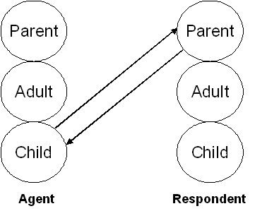

Slide 29
Movin’ on up…
Recovery is a process
Progression of recovery is “up”
Returning behavioral control to Cortex
Learning to manage emotions
Respond rather than react
Healthy relationships re-engage Cortex
Activate the “Social Computer”

Slide 30
Reactivity Management Strategy
Breathe; Get calm & centered
Remember Compassion (caregivers incl.)
Identify Imbalances
Empower with measured Response
Use “I” messages

Slide 31
Strategy, cont’d.
Do Not:
Engage the reactivity
Invalidate others’ points of view
Do:
Self care & team care
“Tea for the Soul” (Chaplains’ office)

Slide 32
Parable of the Two Wolves
Young Brave in distress about inner conflict
Counsel of a tribal Elder
“You have two wolves within you, fighting for your soul;
“One is good and one is evil.”
“Which wolf will win?”
“Whichever one you feed!”

Slide 33
References
Beauchamp TL, Childress JF. Principles of biomedical ethics, 5th ed. New York City, NY: Oxford University Press; 2001.

Slide 34
Links:
“Dr. Dave’s” website:
http://www.motiventionist.com/
Managing the Medusa webinar:
http://www.naadac.org/managingthemedusa
Images, public domain:
http://tayloredge.com/reference/Science/
Drugs disrupt neurotransmission course
http://science.education.nih.gov/supplements/nih2/addiction/guide/lesson3-1.htm
Harvard's guide on how addiction hijacks the brain
http://www.helpguide.org/harvard/how-addiction-hijacks-the-brain.htm
NIH's Drugs, Brains, and Behavior: The Science of Addiction:
http://www.drugabuse.gov/publications/drugs-brains-behavior-science-addiction/drugs-brain

Slide 35
Links, cont’d:
NIH's curriculum for High School students, "The Brain: Understanding Neurobiology Through Addiction"
http://science.education.nih.gov/supplements/nih2/addiction/default.htm
NIDA main web site:
http://www.drugabuse.gov/
McGill University, "The Brain from Top to Bottom":
http://thebrain.mcgill.ca/flash/d/d_05/d_05_cr/d_05_cr_her/d_05_cr_her.html
Dartmouth's Neuroscience on-line course, ch.9 on the Limbic System
http://www.dartmouth.edu/~rswenson/NeuroSci/chapter_9.html
Transactional Analysis, original source information:
http://www.ericberne.com/transactional-analysis/

