Slide 1
Managing The Medusa:
The Neurobiology of Addiction, Intervention, and Recovery
“Dr. Dave” Janzen, D. Min., CISM, CAI
Certified Intervention Professional #I0175
“The Motiventionist”
http://www.motiventionist.com/
Rev. 7-28-2015

Slide 2
Objectives
Identify the three primary layers of the brain and their essential functions
Explain the basic processes and structures involved in addiction
Understand how neurobiology informs effective intervention and promotes recovery
Incorporate these fundamental neurobiological concepts into intervention, treatment, and long-term recovery planning

Slide 3
Disclosure
Addiction sucks. Big time.
The presenter has a distinct bias against addiction and this bias will appear throughout the presentation.
Deal with it.

Slide 4
Disclosure (cont’d.)
Dr. Janzen has no financial interest in any of the cited entities, other than to complain about the rest of the tax-guzzling government outside of the cited research bodies.

Slide 5
This is not:
A graduate/medical school course in neurobiology;
A thorough review of current in-depth research
  Though I seek constantly to be informed by this research
A discussion of ASAM, DSM, or ICD criteria
  Necessary for professional assessment and treatment
  Confusing for clients and families
A discussion for the evolution/creation debate
Also not training for home brain surgery

Slide 6
This is:
A broad overview of brain structures and processes
A presentation of images and metaphors to be used by mental health professionals and peer specialists:
  For your own understanding
  To inform choices in clinical practice
  To educate clients
  To coach families in supporting recovery

Slide 7
ASAM Definition of Addiction
Addiction is a primary, chronic disease of brain reward, motivation, memory and related circuitry. Dysfunction in these circuits leads to characteristic biological, psychological, social and spiritual manifestations. This is reflected in an individual pathologically pursuing reward and/or relief by substance use and other behaviors.

Slide 8
ASAM Definition, cont’d.
Addiction is characterized by inability to consistently abstain, impairment in behavioral control, craving, diminished recognition of significant problems with one’s behaviors and interpersonal relationships, and a dysfunctional emotional response. Like other chronic diseases, addiction often involves cycles of relapse and remission. Without treatment or engagement in recovery activities, addiction is progressive and can result in disability or premature death.

Slide 9
Progression to Addiction, then to Recovery
The progress of addictive disease moves control of choices and behaviors
  From the “higher” (or, most recently evolved) cortex
  Down to the more primitive, “reptilian” regions
Intervention seeks to begin the recovery process
  By engaging supportive relationships
  To activate the cortex
Recovery seeks to bring healing and regain control
  Back up into the cortex

Slide 10
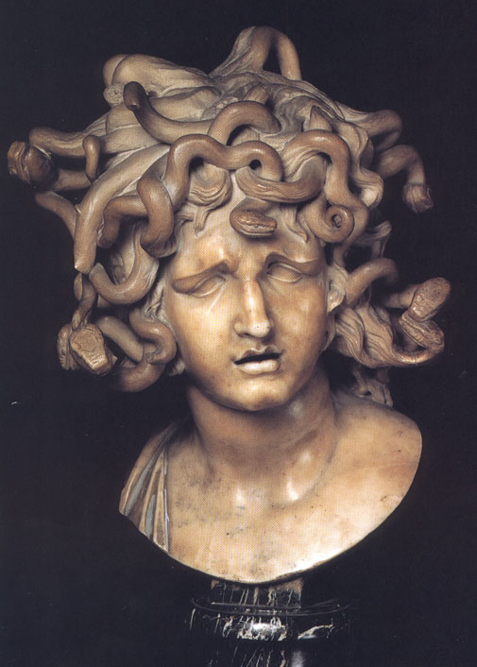
Medusa -Bernini

Slide 11
The Myth of Medusa
From Greek Mythology
  A beautiful priestess of Athena
  Tryst with Poseidon, cursed by Athena
Rings true through the ages because of the power of reptilian behavior
Association of reptilian with frightening, deceptive, and deadly
Including many major religions
And some ex-partners
Notes:
In Greek mythology, Medusa was originally a beautiful priestess of Athena, but a tryst with Poseidon incited Athena to curse her with the hideous appearance that could turn men to stone.
With reptilian effectiveness, addiction hijacks the human brain and sucks the vitality out of a person.
Addiction turns good, loving people into difficult, reptilian reactors.

Slide 12
Addiction and Reptilian Behavior
Most families that have had to deal with the impact of addiction
  Report “S/he has become a different person.”
  “We want our old ______ back”
  Confirmation that some of their behavior is:
    Reactive
    Hostile
    Defensive
It’s an opportunity to ask, “Would you like to know why?”
  And, “Would you like to know what to do about it?”

Slide 13
Addiction is a Process
Begins with choices (mostly)
Some stories of nearly instantaneous addiction
Becomes compulsion
Chemical addiction and behavioral addiction have many of the same underlying structures and processes
These processes move decision-making control
  From the higher brain
  Into the more primitive, reptilian brain

Slide 14
Intervention and Recovery is a process
About moving the control for decision-making back into the higher brain
While managing the powerful influences of the more primitive brain
We do not yet have a “cure”
We can manage symptoms and promote recovery

Slide 15
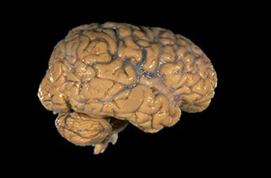
It’s all about that Brain

Slide 16
It’s all about the neurons
Density
Complexity
Ratio
2-3% of body mass
  Uses 15-20% of calories
Organic network of each neuron with the whole brain

Slide 17
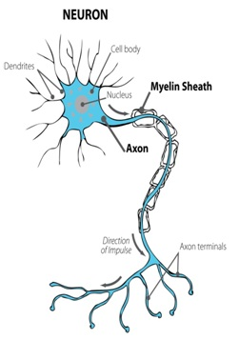

Slide 18
Two modes of communication
Along the neuron
  From the nucleus down to the axon terminals
  Electrical impulses signal instructions to release NT
Between neurons
  Neurochemical
    Neurotransmitters:
      Serotonin, Norepinephrene, Dopamine, glutamate, GABA, etc.
    Other neuropeptides

Slide 19
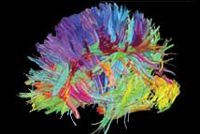
Notes:
A map of the communication pathways in the brain.

Slide 20
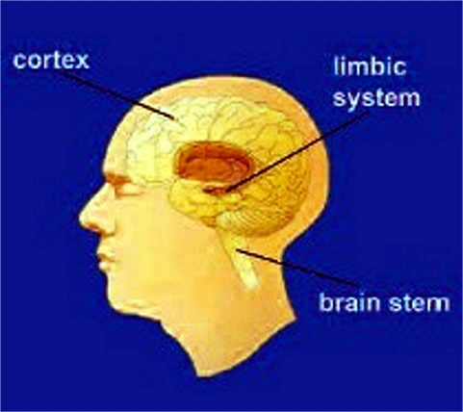
The Brain’s 3 Layers
Upper Layer: Cerebral Cortex
Mid-Brain/Limbic System:
Brainstem:
  Survival
  Reactive
  “Reptilian”
  “Snakes on a Brain”

Slide 21
Cerebral Cortex
Our most-recently-evolved region of the brain
The most significant difference compared to the brains of other species on the planet
Sperm Whale – 17 lbs. of brain, most dedicated to musculoskeletal management
Human brain – 3 lbs.
Human brain has far more neurons, highest ratio of cerebral cortex to body mass & rest of brain of any species
The Cortex is dedicated to integrating sensory & reflective information related to our Social Nature
Cortex is most like a “social computer”

Slide 22
Relationship to our development as “Human”
500,000 years ago, started using tools
50,000 years ago, started using fire
  Allowed migration to colder regions
  Cooking food made more calories available
  More calories made larger “calorie hog” brains possible
Nevertheless, ancestors always near extinction
  Exposure
  Starvation
  Disease
  Competition

Slide 23
The Cortex as “Social Computer”
Our social nature put us at the top of the food chain
Massive processing is required for:
  Language
  Tone of voice and facial expression
  Social group cues of:
    Hierarchy, Threat, Nurture
Social interaction with the environment
  Hunting/gathering
  Security
  Shelter
Technology – knowledge & skill accumulation/sharing

Slide 24
The Mid-Brain, Limbic System
Emotional and sensory processing and response
The primary feeling and reacting centers
Many separate structures for self and species preservation
  Amygdala – Fear, Rage & reactivity with environmental cues
  Hippocampus – Memory and Spatial interaction; Patterns
  Hypothalamus – Endocrine, Sexual, and Autonomic control
    Temperature regulation
    Arousal and Craving
  Hypothalamus also outputs limbic processes to the rest of the brain
Found in the earliest mammals and since

Slide 25
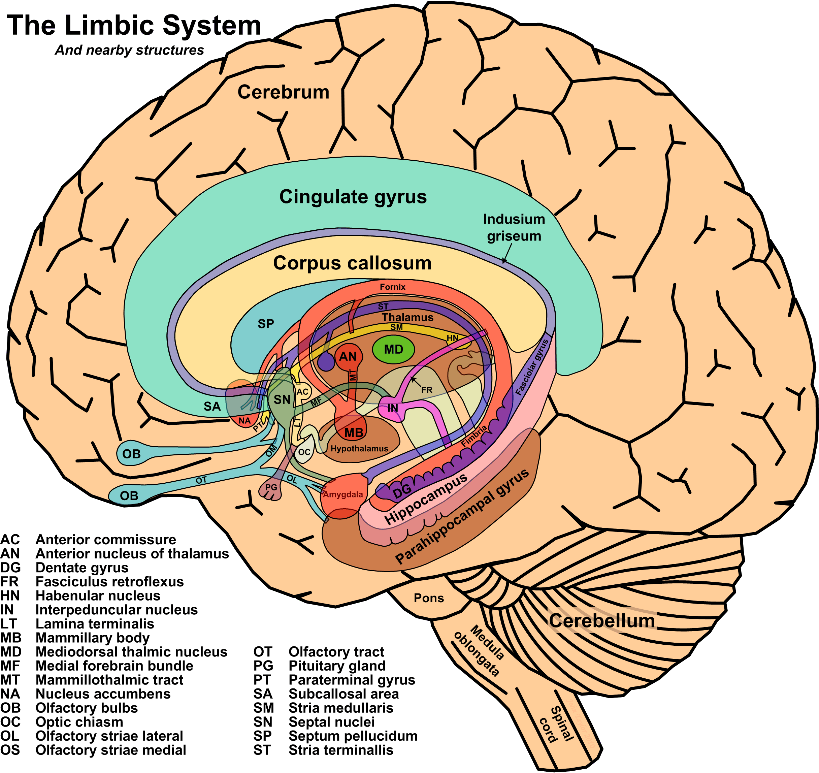

Slide 26
The Reptilian Mind
So-called because it’s as far as reptiles evolved
Reptiles don’t nurture their young
Reptiles are purely reactive creatures
Includes the Brainstem and Cerebellum (coordination)

Slide 27
The Reward Pathway
Natural Rewards
Food
Water
Sex
Nurture
(Air)

Slide 28
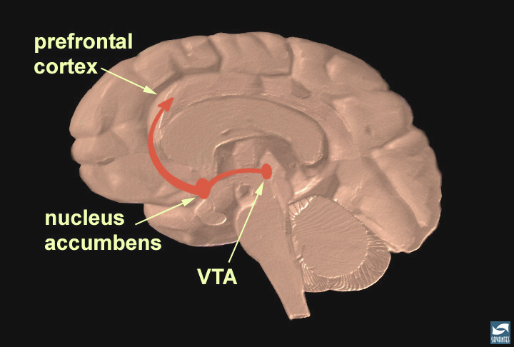
Notes:
The reward pathway
Tell your audience that this is a view of the brain cut down the middle. An important part of the reward pathway is shown and the major structures are highlighted: the ventral tegmental area (VTA), the nucleus accumbens and the prefrontal cortex. The VTA is connected to both the nucleus accumbens and the prefrontal cortex via this pathway and it sends information to these structures via its neurons. The neurons of the VTA contain the neurotransmitter dopamine which is released in the nucleus accumbens and in the prefrontal cortex (point to each of these structures). Reiterate that this pathway is activated by a rewarding stimulus. [Note: the pathway shown here is not the only pathway activated by rewards, other structures are involved too, but only this part of the pathway is shown for simplicity.]

Slide 29
Pleasure: One Mechanism
All Human pleasure has one mechanism
The release of Dopamine by neurons in the Nucleus Accumbens (and the VTA)
Intensity is determined by
  The speed of Dopamine release
  The number of cells releasing, and their amount released
  The time Dopamine spends on receptors and in the Neural Synapse
With repeated use, Glutamate (a neurotransmitter associated with learning) is released
This generates an association (behavioral memory); so that experience becomes motivation, leading to intense craving
Permanent association with natural rewards

Slide 30
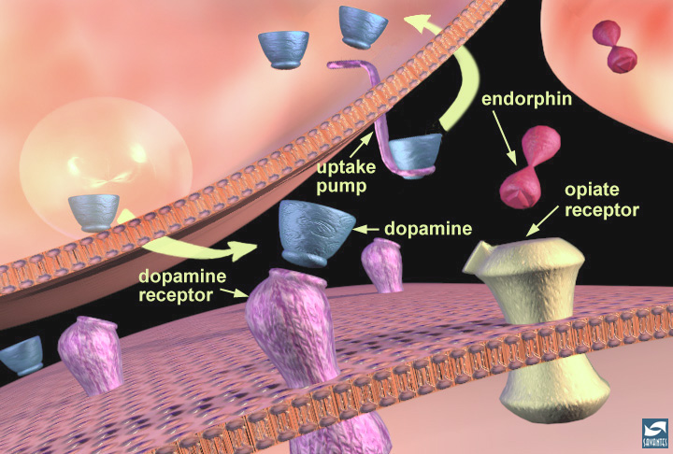
Notes:
Dopamine neurotransmission and modulation by endogenous opiates
Using the close-up of a synapse, continue using dopamine for your example of synaptic function. Explain that it is synthesized in the nerve terminal and packaged in vesicles. Reiterate the steps in neurotransmission. Show how the vesicle fuses with the membrane and releases dopamine. The dopamine molecules can then bind to a dopamine receptor (in pink). After the dopamine binds, it comes off the receptor and is removed from the synaptic cleft by uptake pumps (also proteins) that reside on the terminal (arrows show the direction of movement). This process is important because it ensures that not too much dopamine remains in the synaptic cleft at any one time. Also point out that there are neighboring neurons that release another compound called a neuromodulator. Neuromodulators help to enhance or inhibit neurotransmission that is controlled by neurotransmitters such as dopamine. In this case, the neuromodulator is an "endorphin" (in red). Endorphins bind to opiate receptors (in yellow) which can reside on the post-synaptic cell (shown here) or, in some cases, on the terminals of other neurons (this is not shown so it must be pointed out). The endorphins are destroyed by enzymes rather than removed by uptake pumps.

Slide 31
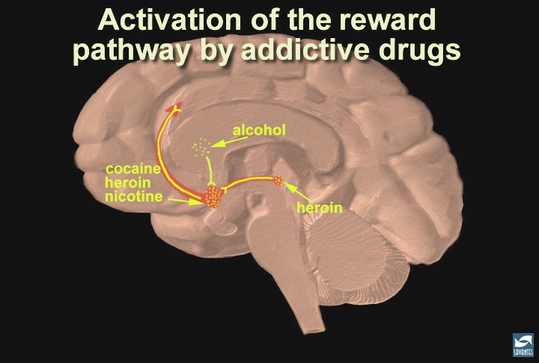
Notes:
Summary; addictive drugs activate the reward system via increasing dopamine neurotransmission
In this slide, the reward pathway is shown along with several drugs that have addictive potential. Just as heroin (morphine) and cocaine activate the reward pathway in the VTA and nucleus accumbens, other drugs such as nicotine and alcohol activate this pathway as well, although sometimes indirectly (point to the globus pallidus, an area activated by alcohol that connects to the reward pathway). While each drug has a different mechanism of action, each drug increases the activity of the reward pathway by increasing dopamine transmission. Because of the way our brains are designed, and because these drugs activate this particular brain pathway for reward, they have the ability to be abused. Thus, addiction is truly a disease of the brain. As scientists learn more about this disease, they may help to find an effective treatment strategy for the recovering addict.

Slide 32
Stages of Progression,
Abstinence to Addiction
Abstinence
Use
Abuse
Tolerance
Dependence
Addiction

Slide 33
What is “Abuse?”
“More than is healthy”
NIAAA studies
Plan to stay safe
Measure every drink
A shot glass for every bottle

Slide 34
Dependence
Brain only functions “normally” in the presence of the drug/behavior
Repeated use overworks & damages neurotransmitter systems
Without drug/behavior, significant physiologic withdrawal symptoms occur
Continued use becomes about avoiding withdrawal symptoms
By this point, drug/behavior has made a permanent connection with the reward pathway & the primitive (reptilian) brain
Early abstinence is experienced as life-threatening by the reptilian mind

Slide 35
Addiction
Dependence is the physiological condition
Addiction is the compulsive response to dependence
Loss of control in limiting use
Example: returning Vietnam Veterans
These distinctions are not part of the ICD or DSM clinical diagnosis or treatment criteria, “Substance Use Disorder” dimensions
This is to help clients/families make their own choices in response to presenting problems

Slide 36
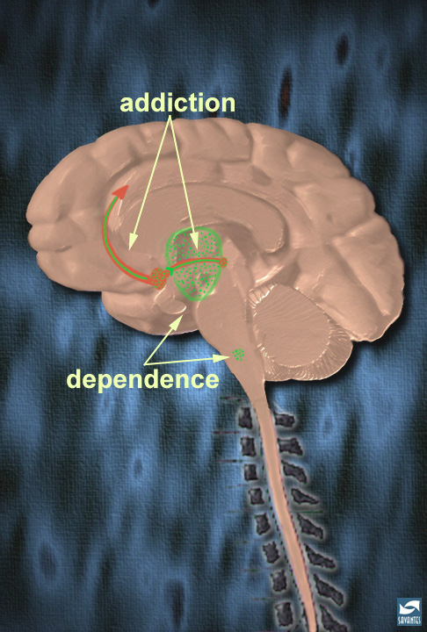
Notes:
Addiction vs dependence
As you have just explained, different parts of the brain are responsible for the addiction and dependence to heroin and opiates. Review the areas in the brain underlying the addiction to morphine (reward pathway) and those underlying the dependence to morphine (thalamus and brainstem). Thus, it is possible to be dependent on morphine, without being addicted to morphine. (Although, if one is addicted, they are most likely dependent as well.) This is especially true for people being treated chronically with morphine for pain, for example associated with terminal cancer. They may be dependent--if the drug is stopped, they suffer a withdrawal syndrome. But, they are not compulsive users of the morphine, and they are not addicted. Finally, people treated with morphine in the hospital for pain control after surgery are unlikely to become addicted; although they may feel some of the euphoria, the analgesic and sedating effects predominate. There is no compulsive use and the prescribed use is short-lived.

Slide 37
Alcohol’s 1-2-3 Punch
In addition to (1) the Reptilian survival mechanisms pounding out the “Booze or die!” message;
(2) Craving-specific neuropeptides in the paraventricular region of the hypothalamus will generate alcohol cravings, which will increase exponentially if alcohol is consumed, even in small doses; and,
(3) Alcohol’s sedating effect on the prefrontal cortex executive functioning dampens the ability to make safe and well-reasoned decisions

Slide 38
E.g., “Why is (my kid) acting that way?
Because addiction “lives” in the “reptilian mind”
Or, as I like to call it,
  “Snakes on a Brain,”
Results in reptilian behavior
Quitting feels like dying in the primitive brain
Defensiveness, denial, reactivity
  Are not about you
  It’s about the disease defending itself
  Like a rattlesnake

Slide 39
How does this inform choices? Families can:
Think strategically for outcomes
  Instead of tussling over who’s right/wrong
Collaborate to manage reactivity
  Instead of reacting
  Choose to respond
Set common family goals for well-being
  Instead of focusing on the AI
  As a “problem to be fixed”
Don’t take the AI’s actions personally
  It’s not about you!

Slide 40
Intervention & Treatment
When an addicted individual can’t or won’t stop
  Intervention may be necessary
  Why professionals?
Different Models
Part of the Continuum of Care
Notes:
Client-centered intervention will provide a case-management approach that includes coaching/training/treatment for family and shepherding through all of the aspects of the first year of recovery.

Slide 41
What Is An Intervention?
Marshalling resources to manage resistance
  Leveraging significant relationships
  Overwhelming the Addicted Individual with love
Crucial moment/opportunity
  Not just for detox/rehab
  Recovery is for everyone involved
Continuum of care for at least a year
  For the Addicted Individual
  For the family & significant others

Slide 42
Job #1: Managing Reactivity
Because dependence/withdrawal lives in the “reptilian mind”
  “Snakes on a Brain”
  Reactivity is a defense mechanism
Reactivity is contagious!
Cats metaphor
Expect reactivity to emerge
Prepare to manage reactivity

Slide 43
The Intervention Team
Highly reactive family members may be asked
  To not participate
  To only write a letter
Pre-intervention orientation & coaching
  Educate about the brain disease of addiction
  Focus on the problem of reactivity
Get confirmation from each member of the team that they:
    Understand the issue
    Commit to remain calm

Slide 44
Guidelines for all Intervention meetings
Review group goals & ground rules
Monitor group for signs of reactivity
  Posture, Tone of voice, Facial expressions
  Watch out for Hi-jackers
Monitor self!
Take breaks
Keep the tone respectful and loving
Focus on building value in relationships

Slide 45
Family Follow-up
Homeostasis
Coaching to encourage, not enable
Try to identify “family rules,” patterns
Job #1- Identify & manage reactivity
Transactional Analysis training
  P – A – C
  Parent/Adult/Child communication dynamic
  Move from “You…” to “I…” messages

Slide 46
The Recovery Message
Involve entire Intervention Team in building the message
  Use the Rec. Msg. to keep team on track
  Avoid Red Herrings
  Helpful in preventing a hi-jacking of the process
I use the SAMHSA recovery definition as a starting place
  Works for Psychiatric Interventions (Bi-polar, psychotic pts.)
  Works for everyone involved

Slide 47
Recovery Definition (SAMHSA)
"A process of change through which individuals improve their health and wellness, live a self-directed life, and strive to reach their full potential."

Slide 48
Keep Mind Management Moving UP
Addiction is a process
  Involves the whole brain
  “Resides” (is most active in) the more primitive brain
Progression of the disease is “down”
  From choice to compulsion
Behavioral control moves from Prefrontal Cortex
To compulsive drives of the reptilian/limbic
Choice surrenders to over-riding demands of the reptilian mind

Slide 49
Movin’ on up…
Recovery is also a process
Progression of recovery is “up”
  Returning behavioral control to Cortex
Learning to manage emotions
Respond rather than react
Peer groups (AA, NA, Smart Recovery, etc.)
Healthy relationships re-engage Cortex
  Activate the “Social Computer”

Slide 50
This is why:
Confrontation seldom provides lasting benefits
Also why the recovery groups work
  Few stories of recovery in isolation
Sponsors, meetings, recovery friends
Healthier family functioning is not optional
Motivational Interviewing works
Spirituality helps
  Looking beyond self is “higher brain” activity

Slide 51
Parable of the Two Wolves
Young Brave in distress about inner conflict
Counsel of a tribal Elder
“You have two wolves within you, fighting for your soul;
“One is good and one is evil.”
“Which wolf will win?”
“Whichever one you feed!”

Slide 52
Links:
“Dr. Dave’s” website:
  http://www.motiventionist.com/
Managing the Medusa webinar:
  http://www.naadac.org/managingthemedusa
Images, public domain:
  http://tayloredge.com/reference/Science/
Drugs disrupt neurotransmission course
  http://science.education.nih.gov/supplements/nih2/addiction/guide/lesson3-1.htm
Harvard's guide on how addiction hijacks the brain
  http://www.helpguide.org/harvard/how-addiction-hijacks-the-brain.htm
NIH's Drugs, Brains, and Behavior: The Science of Addiction:
  http://www.drugabuse.gov/publications/drugs-brains-behavior-science-addiction/drugs-brain

Slide 53
Links, cont’d:
NIH's curriculum for High School students, "The Brain: Understanding Neurobiology Through Addiction"
  http://science.education.nih.gov/supplements/nih2/addiction/default.htm
NIDA main web site:
  http://www.drugabuse.gov/
McGill University, "The Brain from Top to Bottom":
  http://thebrain.mcgill.ca/flash/d/d_05/d_05_cr/d_05_cr_her/d_05_cr_her.html
Dartmouth's Neuroscience on-line course, ch.9 on the Limbic System
  http://www.dartmouth.edu/~rswenson/NeuroSci/chapter_9.html
Transactional Analysis, original source information:
  http://www.ericberne.com/transactional-analysis/

Slide 54


